Slide 1
Phase identification with using voltage profile data
Project 1
Data Analytics for Smart Grids
Phase identification with using voltage profile data
Antonio Villas Bôas and Jonas Betscher
April 15th, 2024

Slide 2
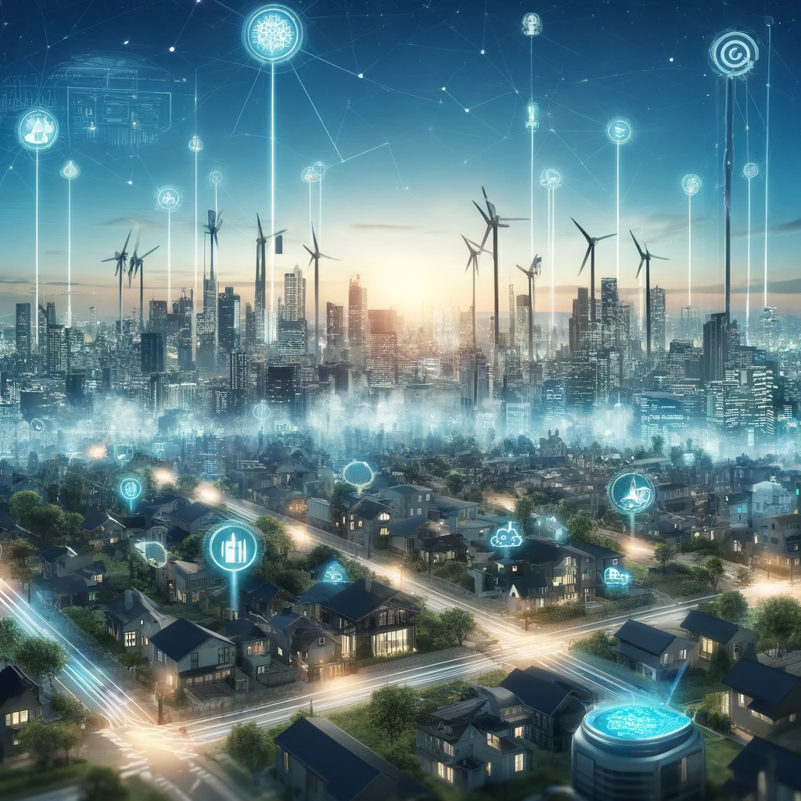
Project Goal
Benefits of Smart Grids:
Increased energy efficiency and reliability;
Enhanced capacity for demand response;
Real-time Monitoring and Control;
Challenges of Phase Identification:
Per-phase aggregate energy measurements are usually unavailable;
Incorrect identification leads to energy loss;
Impact on load balancing between phases
Data Analytics for Smart Grids
Phase identification with using voltage profile data
Antonio Villas Bôas and Jonas Betscher
April 15th, 2024

Slide 3

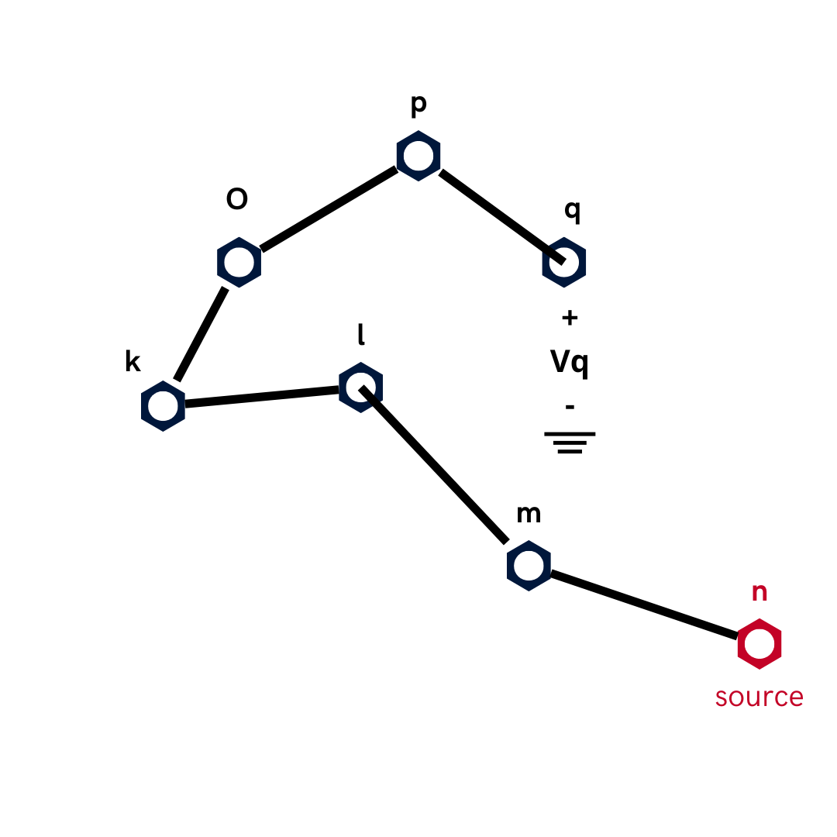
Data Overview
Same data from lab 6-7 with extras:
Added 6 new consumers (10 in total);
New network;
We took the apparent power data s from Lab 6-7 to generate new columns for each new consumer;
Now each phase has at least 2 consumers;
Figure 1 – new network topology
Data Analytics for Smart Grids
Phase identification with using voltage profile data
Antonio Villas Bôas and Jonas Betscher
April 15th, 2024

Slide 4
Data Overview
t | Apparent power with new consumers
1 | 0.045 | 0.015 | 0.047 | 0.033 | 0.016 | 0.024 | 0.028 | 0.02 | 0.259 | 0.02
2 | 0.025 | 0.015 | 0.248 | 0.033 | 0.045 | 0.015 | 0.02 | 0.028 | 0.394 | 0.028
3 | 0.097 | 0.025 | 0.394 | 0.033 | 0.028 | 0.022 | 0.016 | 0.015 | 0.017 | 0.024
4 | 0.07 | 0.049 | 0.02 | 0.485 | 0.016 | 0.02 | 0.015 | 0.201 | 0.024 | 0.015
5 | 0.125 | 0.046 | 0.016 | 0.143 | 0.394 | 0.07 | 0.026 | 0.049 | 0.046 | 0.015
6 | 0.29 | 0.027 | 0.016 | 0.047 | 0.049 | 0.206 | 0.049 | 0.015 | 0.033 | 0.015
7 | 0.259 | 0.015 | 0.017 | 0.02 | 0.29 | 0.045 | 0.047 | 0.046 | 0.015 | 0.206
8 | 0.259 | 0.016 | 0.028 | 0.016 | 0.026 | 0.026 | 0.206 | 0.097 | 0.047 | 0.046
9 | 0.442 | 0.016 | 0.05 | 0.017 | 0.13 | 0.028 | 0.394 | 0.046 | 0.049 | 0.016
10 | 0.201 | 0.023 | 0.046 | 0.016 | 0.047 | 0.143 | 0.046 | 0.017 | 0.049 | 0.097
11 | 0.206 | 0.049 | 0.022 | 0.024 | 0.016 | 0.026 | 0.049 | 0.022 | 0.046 | 0.026
12 | 0.13 | 0.047 | 0.016 | 0.049 | 0.143 | 0.022 | 0.046 | 0.259 | 0.025 | 0.046
13 | 0.046 | 0.026 | 0.017 | 0.048 | 0.259 | 0.016 | 0.13 | 0.016 | 0.017 | 0.097
Used def pf3ph(t,z,si,vr,el,ni,al)
to generate to per-pase voltage measures of Vq
Figure 1 – new network topology
Data Analytics for Smart Grids
Phase identification with using voltage profile data
Antonio Villas Bôas and Jonas Betscher
April 15th, 2024

Slide 5
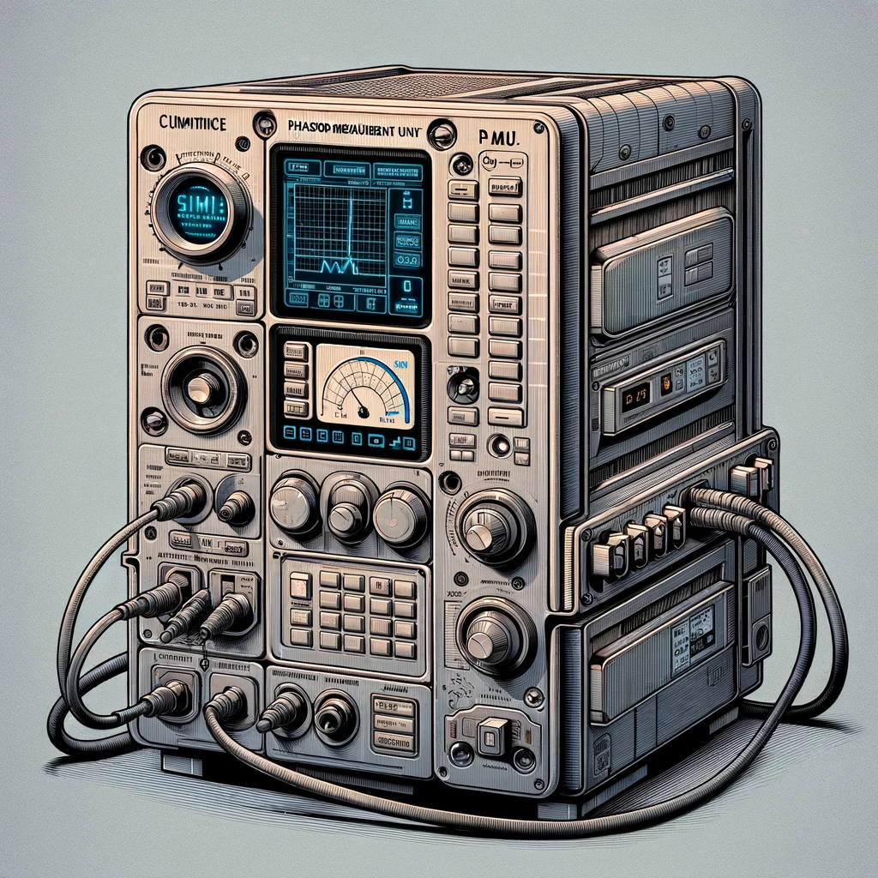
Challenges of voltage measurements
With voltage metering data alone, phase-identification requires more knowledge;
Ideal measurement equipements are hard/costly to implemente;
Alternative: micro Phasor Measument Units (µPMUs)
Data Analytics for Smart Grids
Phase identification with using voltage profile data
Antonio Villas Bôas and Jonas Betscher
April 15th, 2024

Slide 6

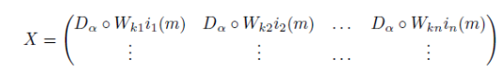
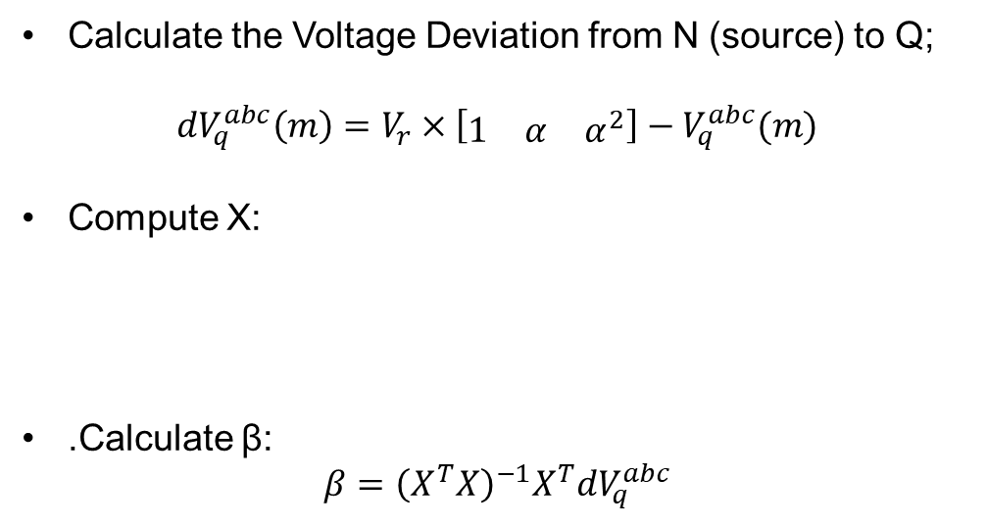
Methodology
Calculate the Voltage Deviation from N (source) to Q;
$${dV}_{q}^{abc}\left(m\right)=V_{r}×\left[\begin{matrix}1 & α & α^{2}\end{matrix}\right]−V_{q}^{abc}(m)$$
Compute X:
.Calculate β:
$$β={\left(X^{T}X\right)}^{−1}X^{T}{dV}_{q}^{abc}$$
Data Analytics for Smart Grids
Phase identification with using voltage profile data
Antonio Villas Bôas and Jonas Betscher
April 15th, 2024

Slide 7

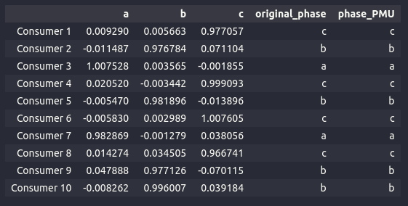
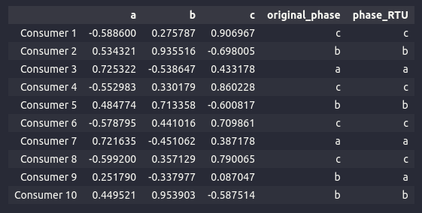

Results
We were able to estimate consumer’s phase with both complex and Absolute values of ${dV}_{q}^{abc};$
RTU had a small error of phase estimation compared to PMU
Figure 2 – Beta values for each consumer using PMU
Figure 3 – Beta values for each consumer using RTU
Data Analytics for Smart Grids
Phase identification with using voltage profile data
Antonio Villas Bôas and Jonas Betscher
April 15th, 2024

Slide 8
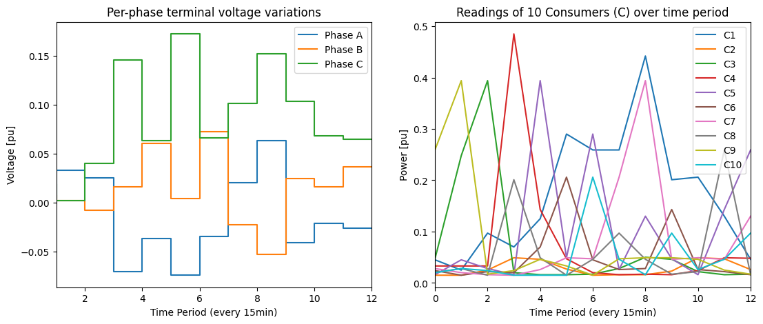
Results
Data Analytics for Smart Grids
Phase identification with using voltage profile data
Antonio Villas Bôas and Jonas Betscher
April 15th, 2024

Slide 9
Data Analytics for Smart Grids
Phase identification with using voltage profile data
Antonio Villas Bôas and Jonas Betscher
April 15th, 2024

